Slide 1
Let’s Cook
Your FooD OUR RECIPE

Slide 2
INTRODUCTION
Let’s Cook is an Android based application for your smartphones and tablets. Just imagine, you are tired of eating the same food all day and make a mind to prepare something interesting of your favourite chef. But this is where you get trapped, where to get the recipe from? This application allows you to search for your favourite chef and view all the recipes of that particular chef. So the task is just to login, search for the chef, choose the recipe and you are done. The recipe is in front of you in 4 simple steps.

Slide 3
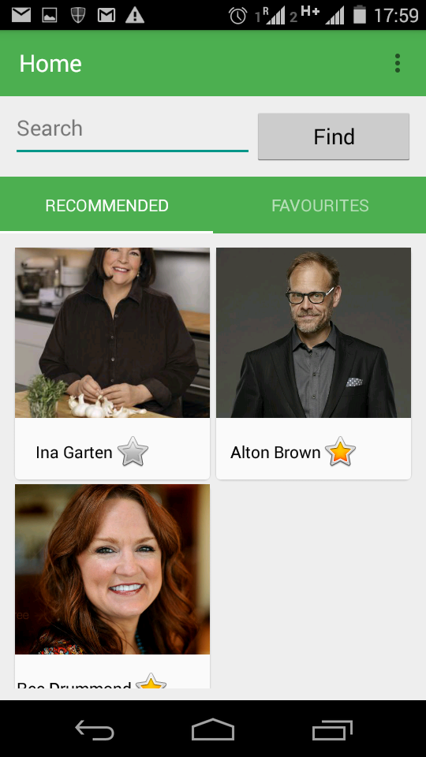
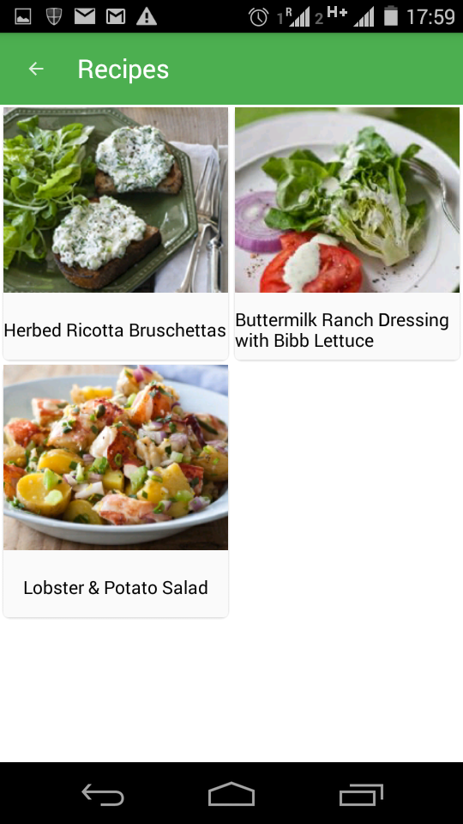
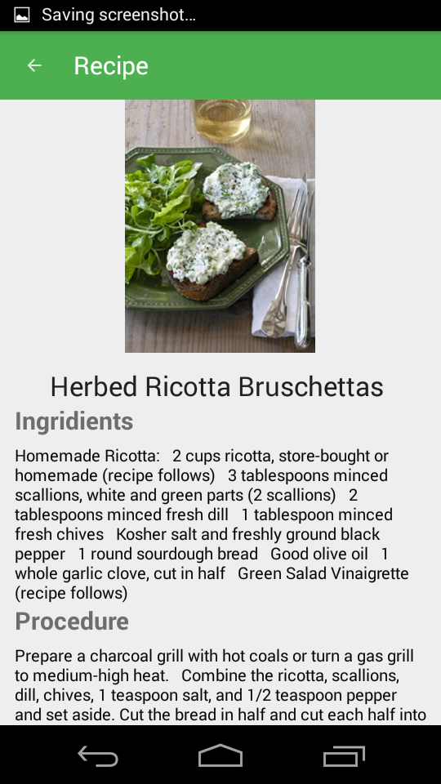
FUNCTIONALITIES
Choose Your Chef
Choose Your Recipe
View Your Recipe
Select any chef from the recommended section.
Choose any from the recipes of this chef.
The selected recipe is displayed with name, image, ingridients and procedure.

Slide 4
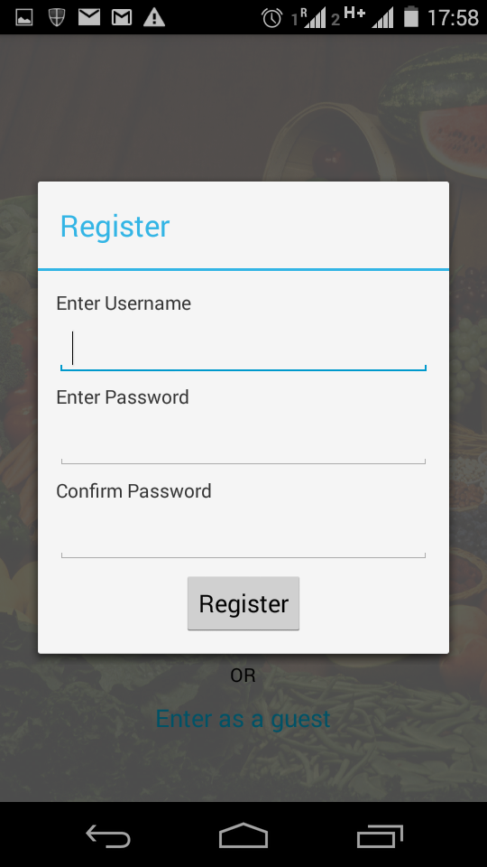
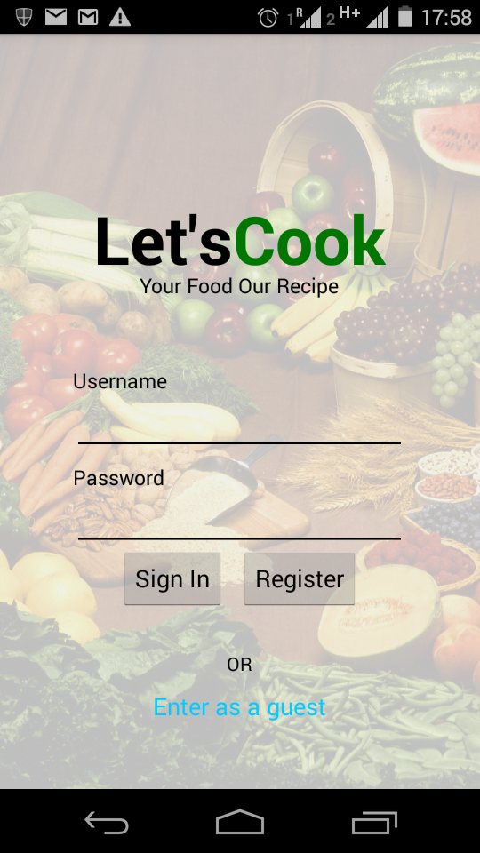
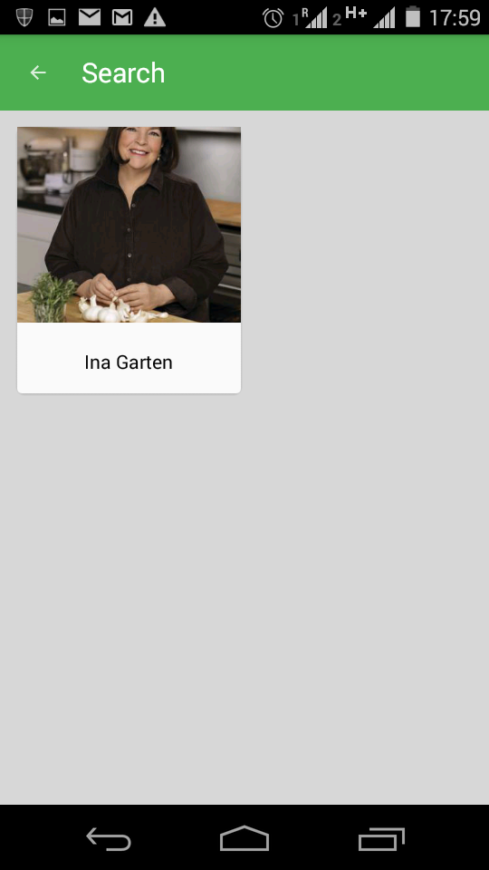
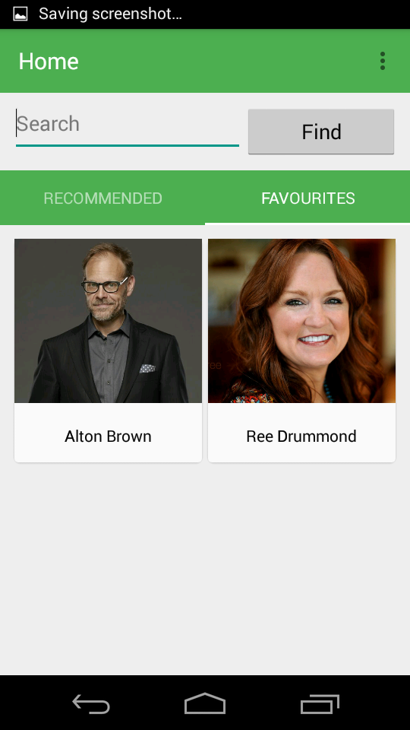
ADVANTAGES
Login And Register System
Mark as favourite and Search
Maintain your own account by logging in to the application. This will help you keep your data safe according to your preferences.
Once you are login, you can mark a chef as your favourite so that you need not search again later. Search for chef using search bar.

Slide 5
FUTURE PROSPECTS
This application can be extended as huge chef-recipe information system.
The recommended chefs will be listed on basis of machine learning algorithms. The type of chefs users view the most, the chefs they mark as favourite can be taken as data and manipulated to give appropriate recommendations.
The app can be used by household workers and restaurants.
The data will be presented with higher aesthetic values and ergonomics.

Slide 6
THANK YOU

